Slide 1

BlockEd Blockchain Network of Student Academic Records

Slide 2
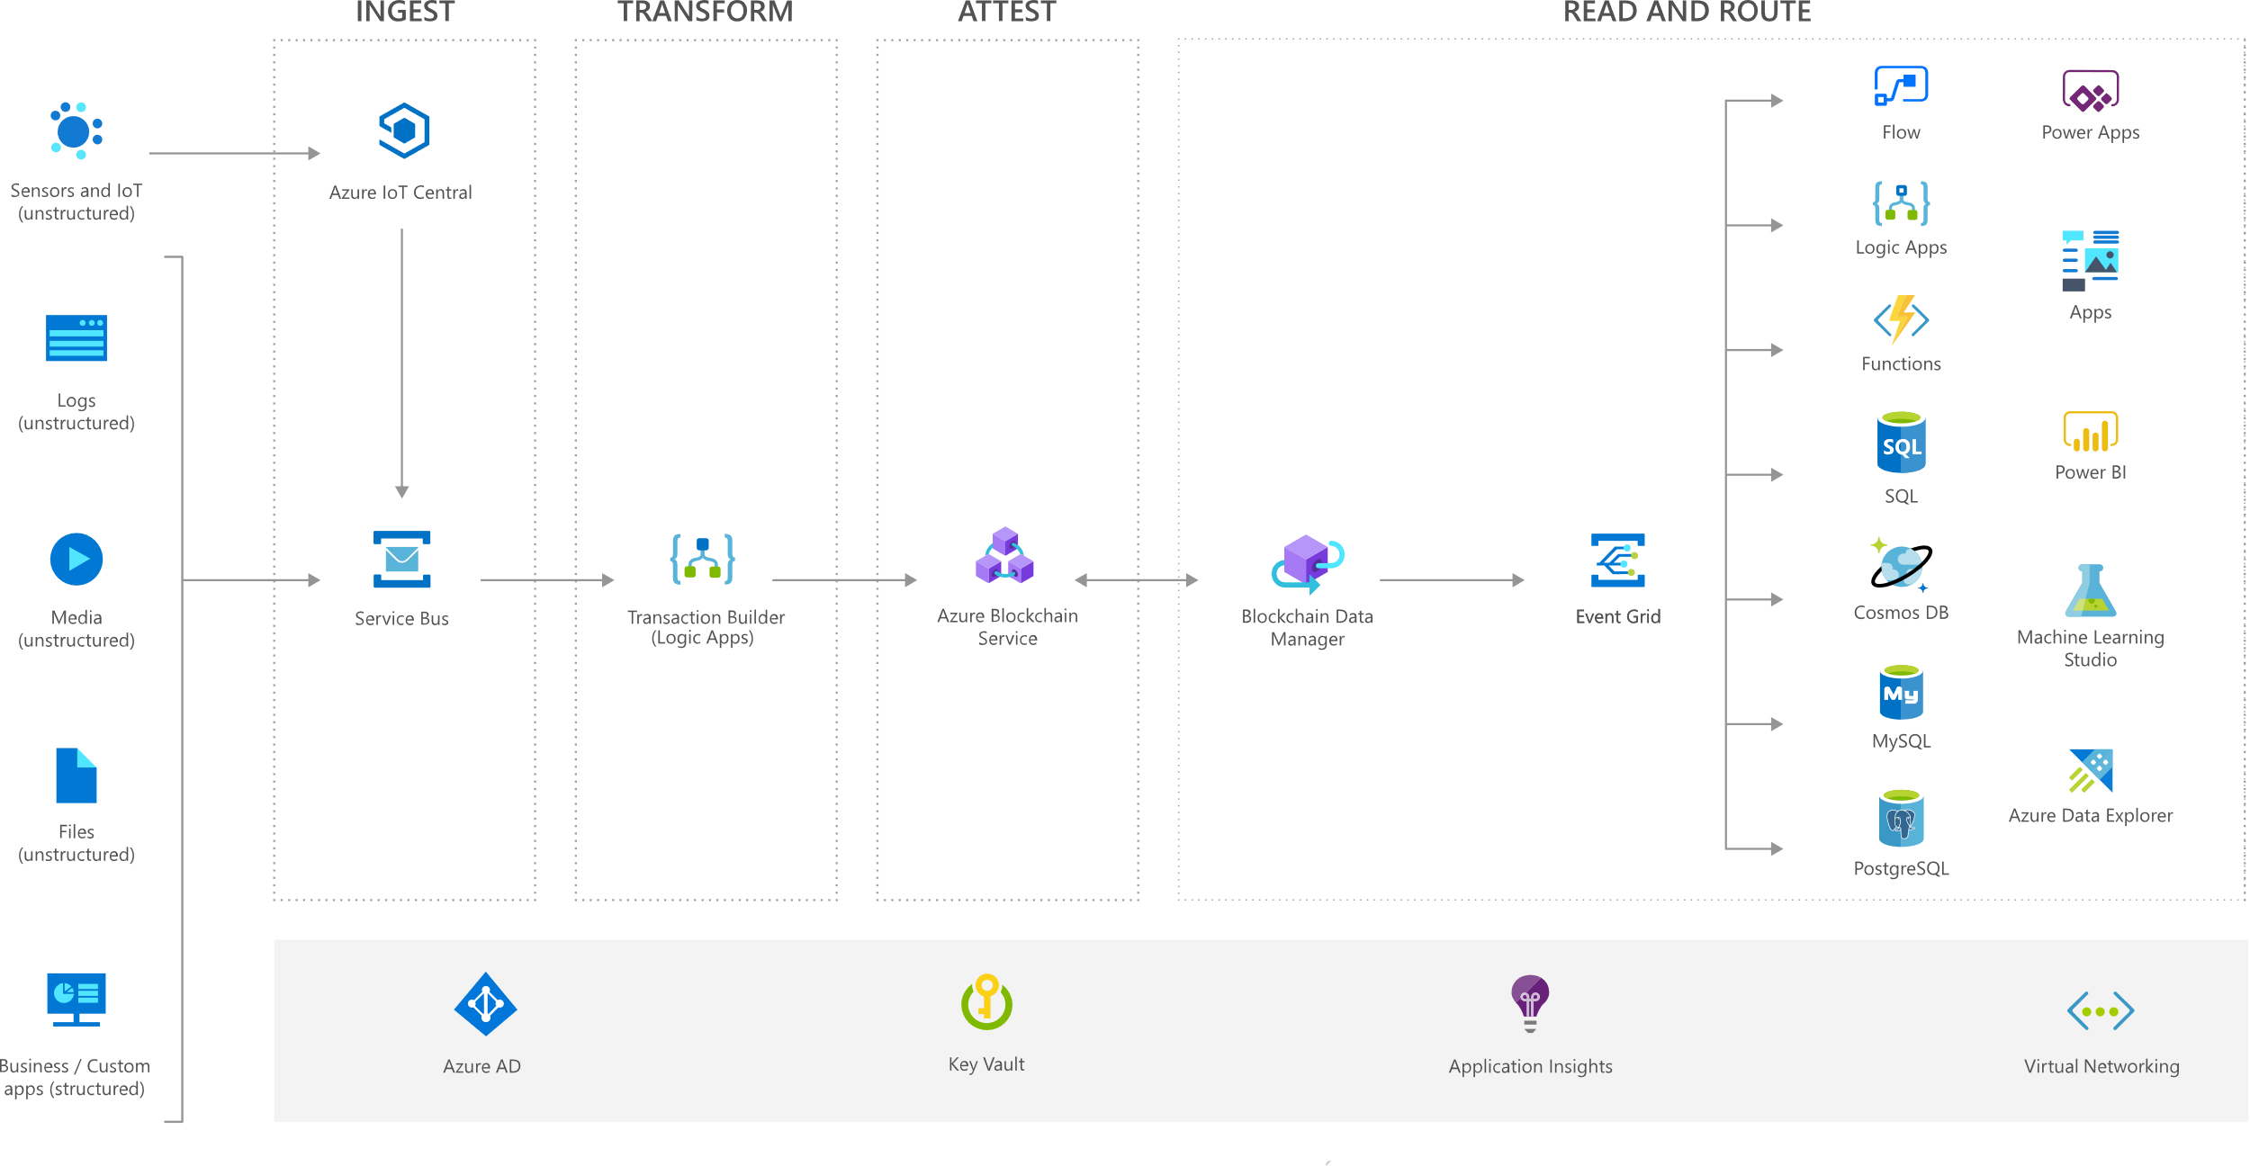
Azure Blockchain Workbench

Slide 3
Design
Request Accepted
Graduation
Degree Accepted by Student
Degree Requested
Degree Offered

